Slide 1

The Beginning
Vitamins, Minerals, and Trace Elements

Slide 2
VITAMINS

Slide 3

Vitamin A
A cofactor for PTH
Necessary for CSF production
Used for epithelial maturation, especially hair, skin, and eyes
Most unique function is night vision
A mild antioxidant
Photo by Ylanite Koppens from Pexels

Slide 4
Free Radicals
MCC: Viral infections
Made by neutrophils
Made by the NADPH-Oxidase system
Cause damage by perforating outer membranes, then destroying the nuclear membrane
Breaks up DNA into pieces

Slide 5
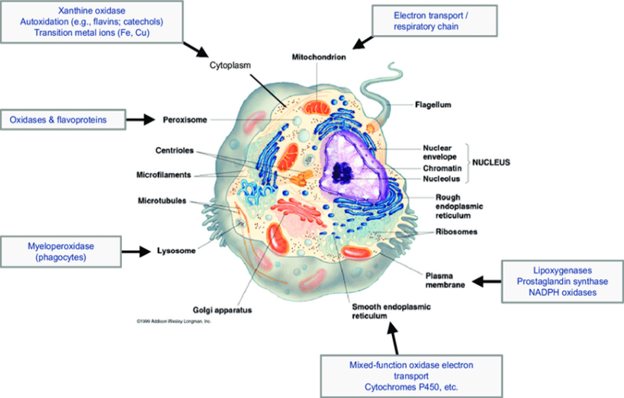
Free Radicals
Figure 2.1 Free Radicals Penetrating the Membrane

Slide 6
Vitamin A Deficiency
Poor night vision
Decreased CSF production: asymptomatic
Hypoparathyroidism
Epithelial cells fail to mature
T(15/17)

Slide 7
T (15/17)
Retinoic acid receptor defect
Seen in:
  Promyeloblastic Leukemia
  Acute Myeloblastic Leukemia

Slide 8
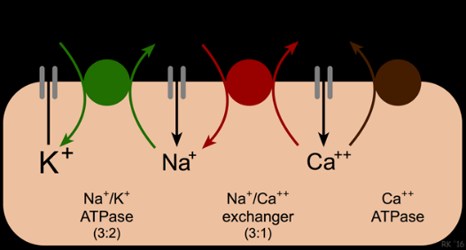
Vitamin A Excess
Pseudotumor cerebri: excess CSF production
Hyperparathyroidism: moans, groans, bones and stones
Figure 2.2 Sodium-Calcium Gradient

Slide 9
Pancreatitis
In Children:
  Trauma
  Infections:
    Coxsackie B virus
    Mumps virus
  Hypertriglyceridemia
  Hypercalcemia
In Adults:
  Gallstones
  Alcohol
  Hypertriglyceridemia
  Hypercalcemia

Slide 10
Metastatic Calcifications
Due to hypercalcemia

Slide 11
Dystrophic Calcifications
Dying cells take up calcium

Slide 12
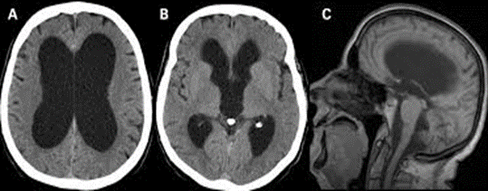
Pseudotumor Cerebri
Sign: papilledema
Symptom: headache
Evaluation: CT scan ( shows enlarged ventricles)
Treatment: d/c vitamin A; serial LPs (30cc at a time)
Main complication: blindness
This is the only cause of increased ICP where you don’t have to worry about herniation
Figure 2.3 CT Dilated Brain Ventricles

Slide 13
Bariatric Surgery
BMI above 40
BMI above 35 with one comorbidity
BMI above 30 with two comorbidities

Slide 14
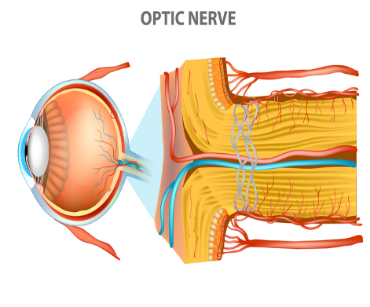
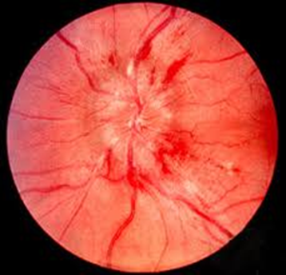
Papilledema
Figure 2.4 Papilledema

Slide 15
Vitamin B1: Thiamine
Necessary for four important enzymes:
  Pyruvate dehydrogenase
  Alpha-ketoglutarate dehydrogenase
  Branched chain amino acid dehydrogenase
  Transketolase

Slide 16
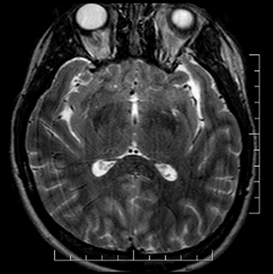
Thiamine Deficiency
Beriberi
  Dry beriberi
  Wet beriberi
Wernicke’s Encephalopathy
  Neurological symptoms; May lead to Wernicke's aphasia
Wernicke-Korsakoff syndrome
  Mamillary bodies now also involved
  Confabulation
  Inability to move short-term memory to long-term memory
Figure 2.5 MRI of Temporal Lobe

Slide 17
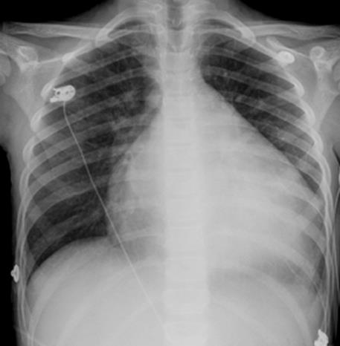
Dilate Cardiomyopathy
Merck Manuals

Slide 18
Vitamin B2: Riboflavin
Used in cofactors (FAD)
Best source is milk
Sunlight breaks riboflavin down

Slide 19
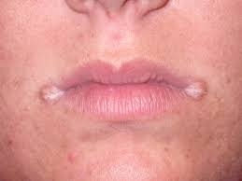
Riboflavin Deficiency
Sunlight breaks riboflavin down
Angular cheilosis
Figure 2.7 Angular Cheilosis

Slide 20
Vitamin B3: Niacin
Necessary for cofactors ( NAD, NADH, NADP, NADPH)
Needed by pyruvate dehydrogenase, alpha-ketoglutarate dehydrogenase, and branched chain amino acid dehydrogenase

Slide 21
Niacin/Probucol
Inhibits VLDL production by the liver
Decreases triglycerides
NIACIN
  Raises HDL by 45%, more than any other drug
  Causes flushing and itching (by prostaglandin release, which leads to histamine release)
  Causes insulin resistance
  Worsens gout

Slide 22
Gout
Most effective drug: Colchicine
First Line Drug: Indomethacin
Patient has renal failure:
  Inject joints with steroids
Chronic or recurrent: Allopurinol or Febuxostat along with Probenecid
To break up crystals: Rasburicase

Slide 23
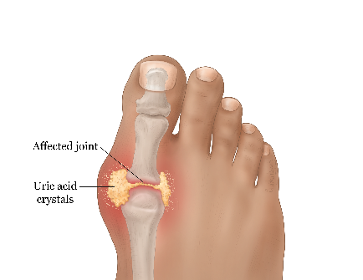
Niacin Deficiency
Pellagra: 4D’s
  Diarrhea, Dermatitis, Dementia and Death
Hartnup's Disease presents just like pellagra
  Defective renal transport of tryptophan
  Presents just like pellagra
  Defective renal transport of tryptophan, causing tryptophan to leak into urine
  Tryptophan is needed to make niacin
  Gout-See Management Section
Figure 2.8 Patient with Gout

Slide 24
Vitamin B4: Lipoic acid
Needed by pyruvate dehydrogenase, alpha-ketoglutarate dehydrogenase, and branched chain amino acid dehydrogenase
No deficiency state

Slide 25
Vitamin B5: Pantothenic Acid
Needed by pyruvate dehydrogenase, dehydrogenase, alpha-ketoglutarate dehydrogenase, and branched chain amino acid dehydrogenase
Used by Coenzyme-A
No deficiency state

Slide 26
Vitamin B6: Pyridoxine
Needed by all transaminases
INH pulls pyridoxine out of the body
Forms the cofactor pyridoxal phosphate

Slide 27
Isoniazid
Pulls vitamin B-6 out of your body

Slide 28
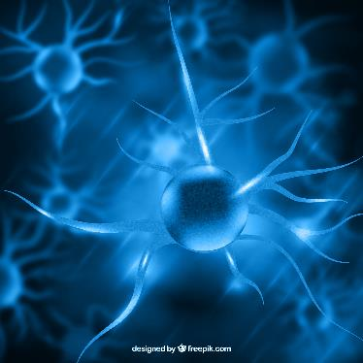
Pyridoxine Deficiency
Neuropathy
  Treatment of Neuropathy
    Amitriptyline
    Gabapentin
    Carbamazepine

Slide 29
Amitriptyline
A TCA
  Blocks reuptake of catecholamines
  Strongly anticholinergic
  Blocks Alpha-1 receptors
  Blocks Sodium channels
  Blocks AV conduction
  Antihistaminic

Slide 30
Gabapentin
Blocks presynaptic calcium channels
Enhances GABA

Slide 31
Carbamazepine
Blocks Sodium channels
Also blocks calcium channels
DOC for Temporal Lobe Seizures
DOC for shooting, stabbing, lancinating neuropathy

Slide 32
Vitamin B9: Folate
The first vitamin to run out whenever you have rapidly dividing cells
Used to make tetrahydrofolate (THF) from which you make nucleotides

Slide 33
Folate Deficiency
Megaloblastic anemia
Hyper segmented neutrophils
Neural tube defects in fetuses
Mcc: overcooked vegetables

Slide 34
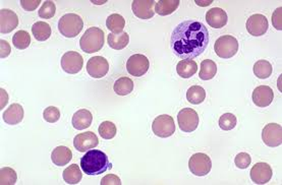
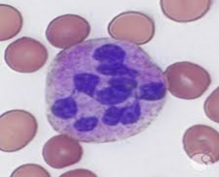
Folate Deficiency
Figure 2.10 Hyper segmented Neutrophils
Figure 2.9 Megaloblastic Cells

Slide 35
Vitamin B12: Cyanocobalamin
Needed by two enzymes:
  Homocysteine methyltransferase
  Methylmalonyl-CoA mutase
Used to make tetrahydrofolate
Used to recycle odd-numbered carbon fatty acids

Slide 36
How to Separate B12 From Folate Deficiency
Neuropathy
Timing
Methylmalonic Acid levels in the urine

Slide 37
Vitamin B12 Deficiency
Megaloblastic anemia
Hyper segmented neutrophils
Neuropathy, especially involving the dorsal column pathways and corticospinal tracts
MCC: pernicious anemia (type A gastritis)

Slide 38
Vitamin C
Used for hydroxylation
Hydroxylates proline and lysine in collagen and elastin
Main antioxidant in the GI system

Slide 39
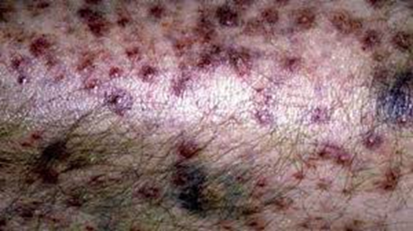
Vitamin C Deficiency
Scurvy
Bleeding from hair follicles and gums
Figure 2.11 Scurvy

Slide 40
Vitamin D
Necessary for bone and teeth formation
Stimulates osteoblastic activity
Stimulates calcium AND phosphorous absorption and reabsorption
Mineralizes bones and teeth

Slide 41
Vitamin D Deficiency
Rickets: in children
Lateral bowing of the legs
Osteomalacia: in adults
Vitamin D resistant rickets
  Defective renal reabsorption of phosphorous
  As phosphorous leaks out, it pulls calcium with it

Slide 42
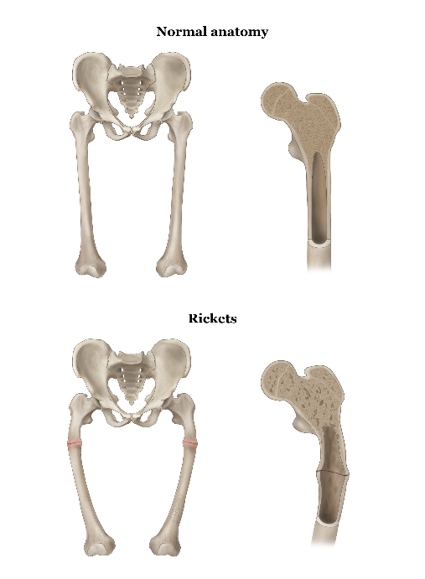
Rickets
Figure 2.12 Patient with Rickets

Slide 43
X-Linked Dominant Diseases
Vitamin D resistant rickets
Pyruvate Dehydrogenase deficiency
Pseudohypoparathyroidism (some cases)

Slide 44
Vitamin E
The main antioxidant in your blood
Absorbs free radicals

Slide 45
Diseases Involving Oxidation
Cancer
Alzheimer’s disease
Coronary artery disease
Hemolytic anemia (esp. G6PD)

Slide 46
Antioxidants
Vitamin E: in blood
Vitamin C: in GI tract
Vitamin A
Beta-Carotene
Trace elements

Slide 47
Theories Behind Aging
Dehydration
Accumulation of free radical damage
Decreased protein synthesis

Slide 48
Biotin
Necessary for carboxylation

Slide 49
Biotin deficiency
Many carboxylases would lose their function

Slide 50
Vitamin K
Needed for gamma-carboxylation
Adds a third (gamma) carboxyl group to the vitamin k dependent clotting factors
  Clotting factors II, VII, IX, X, Protein C & Protein S
  Protein C has shortest half life, followed by factor VII

Slide 51
Warfarin
Competitive inhibitor of vitamin K
Given orally
Always give heparin first with acute venous clots
Crosses the placenta
Teratogenic
Follow PT (prothrombin time)
INR 2 to 3x normal

Slide 52
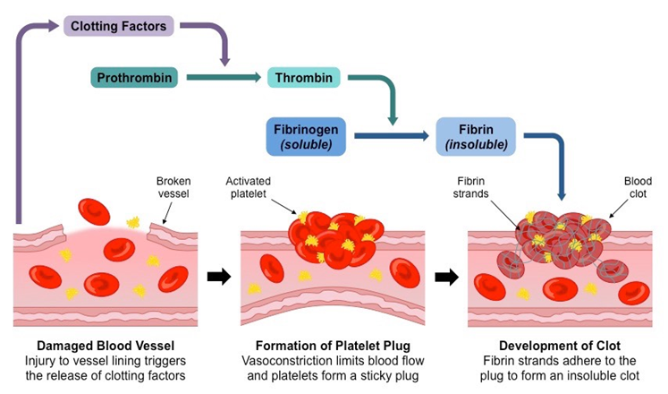
Vitamin K Gamma (γ)- Carboxylation
Figure 2.13 Clotting Cycle

Slide 53
To Reverse Warfarin:
Prothrombin Complex
Fresh Frozen Plasma

Slide 54
Heparin
Acts as a cofactor for antithrombin III
Blocks thrombin, as well as clotting factors IX, X, XI, and XII
  Follow by measuring PTT (INR 2 – 3X NL)
  To reverse the action: protamine sulphate
  If patient acutely bleeding: give FFP to reverse immediately

Slide 55
When You Cannot Use Heparin:
(1) Recent CPR
(2) Recent Head injury
(3) Uncontrolled Hypertension
Put in a Greenfield Filter

Slide 56
Side Effects of Heparin:
Hemorrhage
Activates Hormone-Sensitive Lipase
Heparin Induced Thrombosis

Slide 57
Heparin Induced Thrombosis(HIT)
HIT 1:
  Occurs on day 1 or 2
  Platelet clumping
  Spleen removes them
  Follow platelet count
HIT 2:
  Occurs after day 3
  Autoimmune
  Platelet attaches to platelet surface
  Platelet count drops by at least 75K
  Stop heparin
  Switch to Argatroban

Slide 58
Low Molecular Weight Heparins
Premixed for you
Cheaper overall
Less bleeding complication
NO need to check PTT daily anymore
Contraindicated in renal failure

Slide 59
Paradoxical Strokes
When a DVT leads to a stroke
Patient has a patent foramen ovale

Slide 60
What are germs good for?
Question

Slide 61
Vitamins Related to Gut Flora
They make: 90% of vitamin K
  Biotin
  Folate
  Pantothenic acid
They help absorb
  Vitamin B12

Slide 62
MINERALS

Slide 63
Minerals
Calcium
Magnesium
Zinc
Copper
Iron

Slide 64
Calcium
Intracellular calcium needed for all muscle contraction
Smooth muscle uses extracellular calcium for second messenger systems
Atrium and thalamus are two membranes that uses calcium to depolarize
Cardiac ventricle depends on extracellular calcium to trigger off its intracellular calcium release

Slide 65
Calcium
Used for axonal transport
Presynaptic influx of calcium necessary for release of ALL neurotransmitters
Needed for normal bone and teeth development

Slide 66
Magnesium
A cofactor for ALL kinases
A cofactor for PTH
Interacts with potassium as well somewhere in the early distal convoluted tubules of the kidneys

Slide 67
Zinc
Needed by hair, skin, sperm and taste buds
Zinc deficiency: Dysgeusia

Slide 68
Copper
Needed by lysine hydroxylase in the formation of collagen
Also needed by complex IV of electron transport system

Slide 69
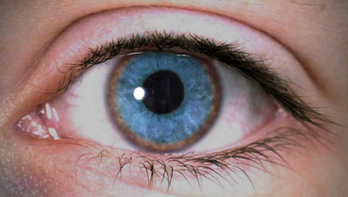
Copper Excess
Wilson’s disease
  Autosomal recessive
  Ceruloplasmin deficiency
  Copper deposition in lenticular nucleus (basal ganglia), iris (Kayser-Fleischer rings), and in the liver (causing cirrhosis)
  Tx: penicillamine
Figure 2.15 Patient with Wilson’s Disease

Slide 70
Autosomal Recessive Inheritance
Most enzymes fall into this category
When there is a family history, the chances are fixed
Chance of getting the disease:
Chance of being a carrier:
What if NO family history?
  Use Hardy-Weinberg equation

Slide 71
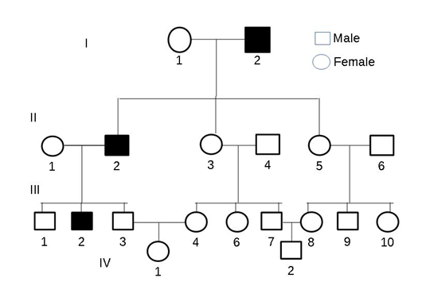
Autosomal Recessive Inheritance
Figure 2.16 Autosomal Recessive Inheritance

Slide 72
Hardy-Weinberg Equation
Aa X Aa = AA Aa Aa aa
P2 + 2pq + q2 =1
p + q = 1

Slide 73
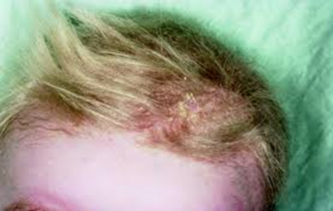
Copper Deficiency
Menke’s Kinky Hair Syndrome
  Orange colored hair
  Hair feels like copper wire
Figure 2.18 Menke’s Kinky Hair Syndrome

Slide 74
Movement Disorder in a Middle-Aged Person
HUNTINGTON’S DISEASE (90%)
  Autosomal dominant
  Trinucleotide repeats
  Involves caudate nucleus
  Has anticipation
  Treat with antipsychotics
  Mcc of death: suicide
WILSON’S DISEASE
  Autosomal recessive
  Ceruloplasmin def
  Copper deposition in lenticular nucleus, liver and iris
  Treat: penicillamine

Slide 75
Trinucleotide Repeats
5 diseased that COULD have trinucleotide re- peats
Huntington’s Disease
Fragile X
Friedreich’s Ataxia
Prader Willi Syndrome
Myotonic Dystrophy

Slide 76
Autosomal Dominant Inheritance
Almost always structural diseases
Chance of getting it if one parent has it:
Chance of getting it if both parents have it:
How to explain someone who has the gene but no disease:
  Incomplete penetrance
Different family members have the SAME gene but look DIFFERENT: variable expression

Slide 77
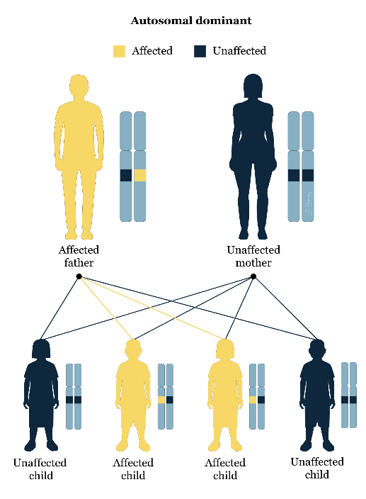
Autosomal Dominant Inheritance
Figure 2.17 Autosomal Dominant Inheritance

Slide 78
Iron
Needed for formation of heme and hemoglobin
Ferrous iron binds oxygen
Needed by complex III and IV of electron transport system

Slide 79
TRACE ELEMENTS

Slide 80
Trace Elements
Chromium
Selenium
Molybdenum
Manganese
Tin
Fluoride

Slide 81
Chromium
Enhances insulin action
Def: causes diabetes

Slide 82
Selenium
Needed primarily by the heart
Excess: breath smells like garlic (arsenic as well)
Def: dilated cardiomyopathy

Slide 83
Molybdenum and Manganese
Needed by many enzymes in glycolysis
Xanthine oxidase: needs both elements

Slide 84
Tin
Needed for hair growth

Slide 85
Fluoride
Needed for teeth and bone growth
Excess: blocks enolase of glycolysis

Slide 86
THE END
BUT it is really the beginning…

